Slide 1
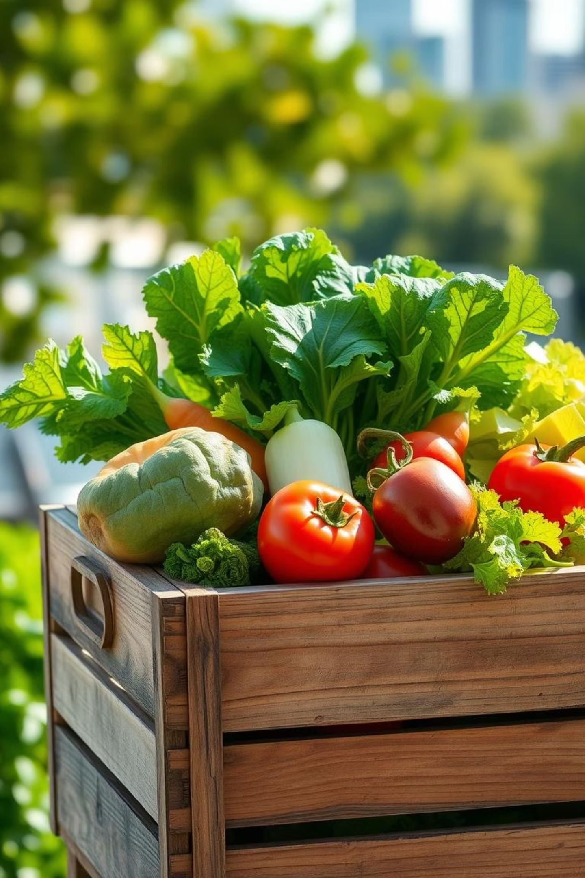
GreenCart: Farm to City
Revolutionising fresh vegetable delivery from farm to urban consumers.

Slide 2
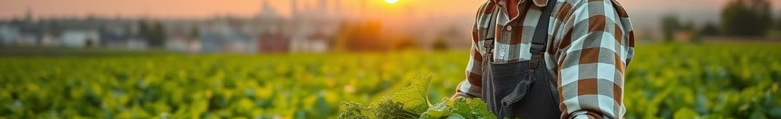
Problem Statement & Objective
Problem: Inefficient Farm-to-City Supply Chain
Objective: Bridging the Gap with FreshHarvest
For Consumers: Urban dwellers often lack consistent access to truly fresh, locally-sourced vegetables. Current lengthy supply chains involve multiple intermediaries and significant transportation, leading to produce that is often days old, has reduced nutritional value, and comes at inflated prices.
To develop and deploy a comprehensive, user-friendly software system, 'FreshHarvest', that directly connects local farmers with urban consumers. This platform will:
Streamline Logistics: Implement an optimized delivery network to minimize transit times and reduce logistical overhead for farmers.
For Farmers: Small to medium-sized farmers face substantial challenges with fragmented and inefficient distribution channels. This results in limited direct market access, high logistical costs, and considerable post-harvest losses (up to 30% of their produce), severely impacting their profitability and sustainability.
Ensure Fair Pricing: Facilitate direct transactions to guarantee equitable returns for farmers while offering competitive prices to consumers.
Enhance Freshness & Quality: Enable consumers to receive farm-fresh produce within 24-48 hours of harvest, significantly improving quality and nutritional value.

Slide 3



Solution Overview
Farmer App
Customer App
Farmers can log in and list the vegetables they currently have available , along with quantity and pricing.
Customers can browse what's available , place order
With just a few taps and also track their order.
Delivery Management
Delivery Management System is the engine that makes everything mov on time. It takes care of assigning the best delivery person based on location ,also updating the stocks , insuring availability.

Slide 4
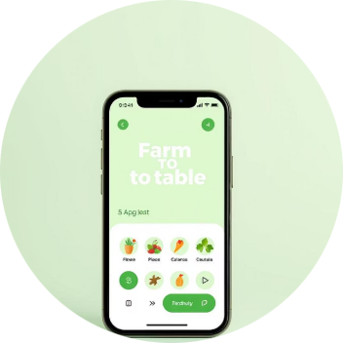
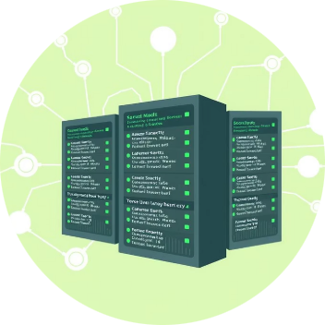

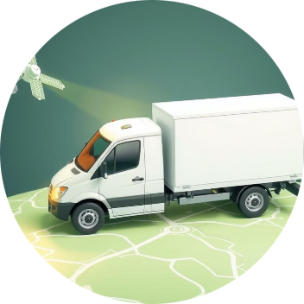
Solution Architecture
Our system connects farmers to consumers through a robust tech stack and integrated services, designed for efficiency and scalability.
Frontend Interfaces
Backend Services
Data Management
Real-time Tracking
We will design two simple Apps for both farmers and customers. These apps are designed to be easy to use on any phone or device.
Behind those apps , there will be a core system that takes care of main work – like receiving orders , updating availability and assigning deliveries.
We also have a safe and organized way of storing data –farmer details , user details , stock ,order history ,payment history.
Integrated IoT and GPS capabilities for live monitoring of deliveries, enhancing transparency and logistics efficiency.

Slide 5
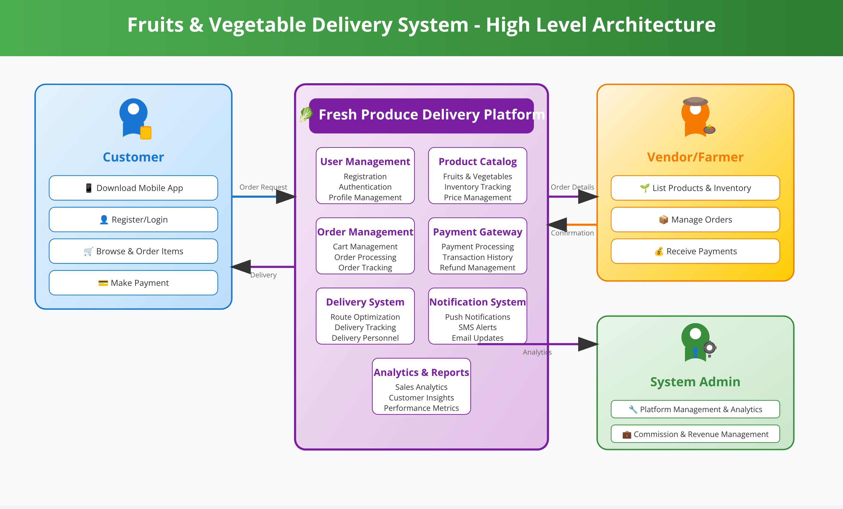

Slide 6
Detailed Flowchart
The end-to-end process from farm to customer, ensuring fresh produce arrives efficiently.
Produce Input
Order Processing
Real-time Delivery
Farmers log available produce and inventory levels into the system.
System processes the order, allocating produce from the nearest city warehouse.
Customers track their orders live, ensuring timely and fresh produce delivery.
1
2
3
4
5
Customer Order
Delivery Assignment
Customers browse, select, and place orders through the dedicated app.
The system assigns the order to an available delivery agent for pickup.

Slide 7
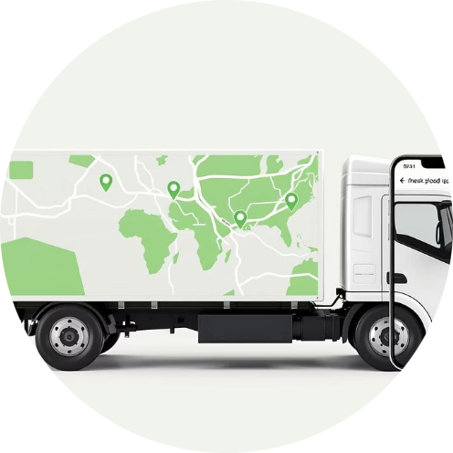
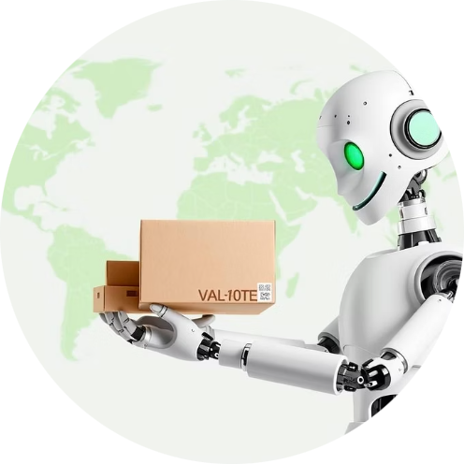


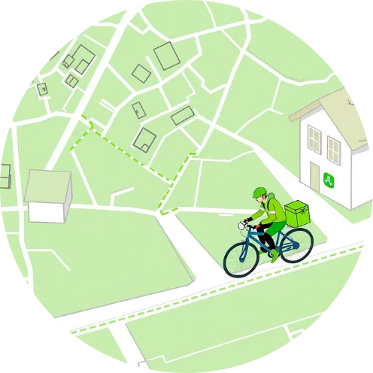
Key Features
Real-time Tracking
Automated Assignment
Feedback System
Monitor inventory and track orders live from farm to city.
Efficient delivery assignment based on pin code and availability.
Allows customers to provide ratings for farmers and delivery services.
Notifications
Route Optimization
Stay informed with timely SMS and push alerts on order status.
Advanced algorithms to optimize delivery routes for bikes and other vehicles.

Slide 8




Future Scope
AI Demand Prediction
Direct Farmer Payments
For stock optimisation and customer demand.
Integration of Payment Gateway (UPI/Banks) for financial transparency
Sustainability Tracking
Subscription Model
Eco-metrics to track
For regular deliveries.

Slide 9
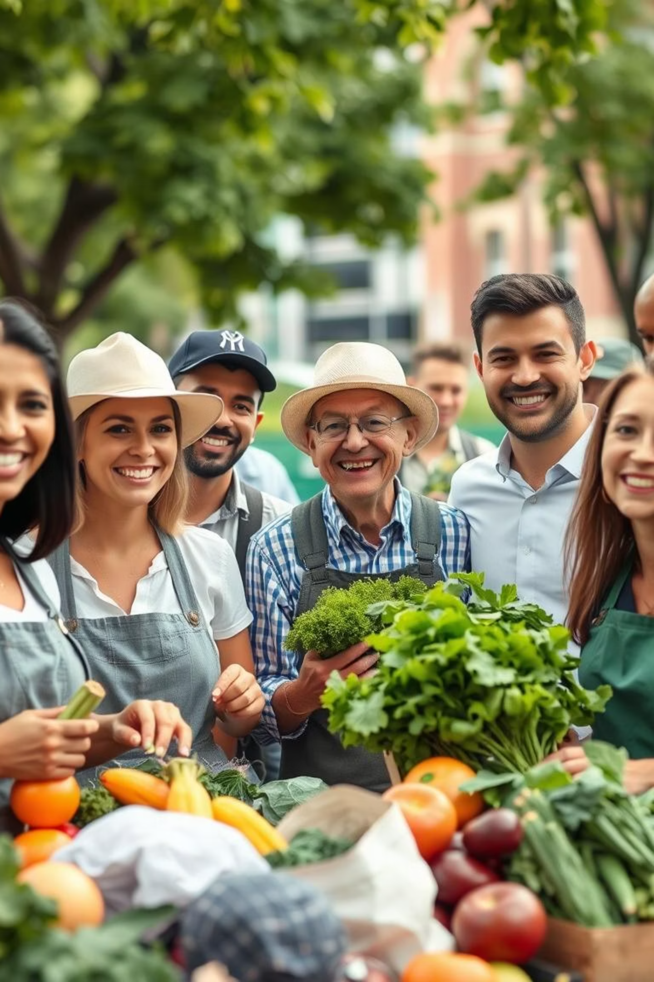
Conclusion
GreenCart offers an efficient, tech-driven farm-to-table delivery system.
It benefits farmers, consumers, and the ecosystem.
Scalable, modular, and ready for smart cities.

